Slide 1

BTMW 4012:
ENTREPRENEURSHIP TECHNOLOGY
Lecture 7:
ORGANIZATIONAL MANAGEMENT FOR START-UP
FPTT- UTeM

Slide 2

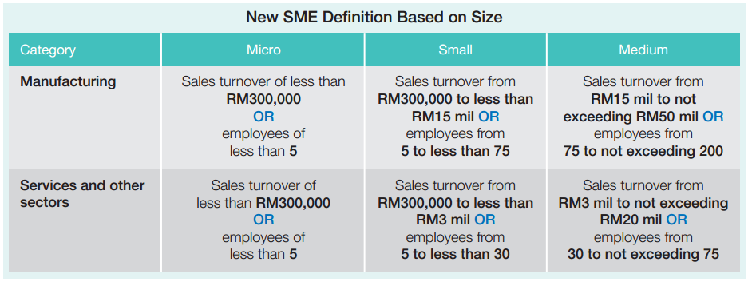
INTRODUCTION
NEW CRITERIA OF
Source: http://www.ecommercemilo.com/2013/12/malaysia-sme-statistics-ecommerce-readiness.html#.UxXKi7dWGUl
FPTT - UTeM

Slide 3

CHARACTERISTICS OF SMEs
OWNERSHIP
MANAGEMENT
RESOURCES
ORGANIZATIONAL STRUCTURE
FLEXIBILITY OF CHANGE
FPTT - UTeM

Slide 4
Introduction
An organization’s objectives are worked out based on the organization’s mission, vision and strategies developed to take advantage of the external opportunities available and to suit the resources that can be mobilized by the organization.
Organization management involves the process of organizing, planning, leading and controlling resources and activities of an organization to achieve the set objectives.

Slide 5
Organization Mission and Vision
The organization mission is an attempt to provide meaning or answer to “why you do, what you are doing and where you are headed”.
In October 2015, Mark Zuckerberg, the Facebook CEO, talked about the importance of having a “strong sense of mission” to effect meaningful change in the world.

Slide 6
Organization Mission and Vision (cont.)
The themes of believing in your mission, caring more deeply than anyone else and always looking ahead is relevant to anything you might build.
Collins and Porras (1994) list the following as mission statements or “whys”. These “whys” are big “whys” that motivate entrepreneurs and those who work for them and with them.
(a) To preserve and improve human life (Merck)
(b) To make people happy (Walt Disney)
(c) To make technical contributions for the advancement
and welfare of humanity (HP)

Slide 7
Organization Mission and Vision (cont.)
The next questions that an entrepreneur must ask are:
(a) “What to do?”
(b) “How to do?”
(c) “When to do?”
(d) “Where to do?”
The answer to these questions will explain the
basic strategies of a particular company.

Slide 8
“What” of Strategy
This refers to the vision or change agenda that the entrepreneur wants to achieve within a time frame.
Organizations normally express their vision statement in a crisp and precise form and it acts as a shared aspiration that provides long-term directions and targets of the organization.
Vision statements always refer to the aspired performance or quality goal in providing products or services within a targeted geographical area of operation and may include the long-term company’s aspirations.

Slide 9
“What” of Strategy (cont.)
Visions must clearly indicate the gap—preferably a quantifiable value gap—between what the firm is today and where it expects to be, say in three years from now.
Based on the example earlier, Facebook started with a vision of having 100 million users. Upon achieving this, the challenge was raised to 1 billion users. The “how” of strategy will be the integrated choices translated into programmes and projects that the organization implements to close the value gap.

Slide 10
“What” of Strategy (cont.)
The company’s business strategies refer to the methods by which the organization choose to achieve its stated objectives. This may include the choice of business sector, products, customers, capabilities, operational areas, technologies, methods of execution or working, investments, borrowings, etc.
For small businesses, this will include the choice of business an entrepreneur would like for a new venture.

Slide 11
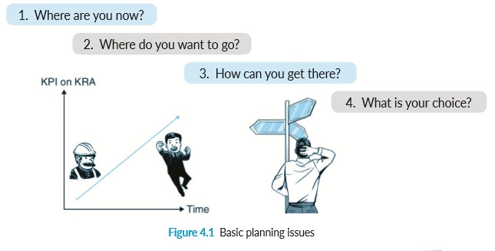
“What” of Strategy (cont.)

Slide 12
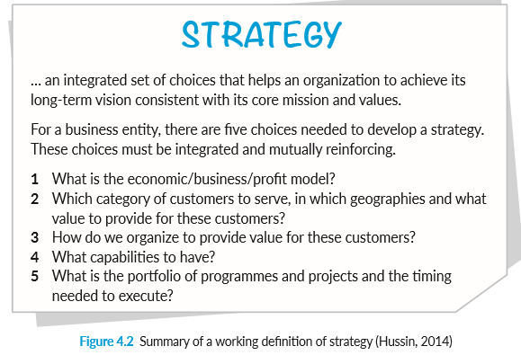
“What” of Strategy (cont.)

Slide 13
“What” of Strategy (cont.)
An entrepreneur may have to do a basic strengths, weaknesses, opportunities, threats (SWOT) analysis to analyze his strengths and weaknesses (internal), and opportunities and threats, (external) to identify suitable business opportunities and strategies. Figure 4.3 illustrates SWOT analysis.

Slide 14
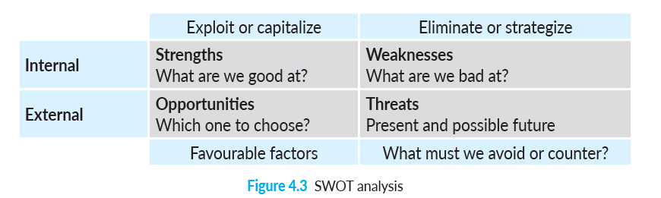
“What” of Strategy (cont.)

Slide 15
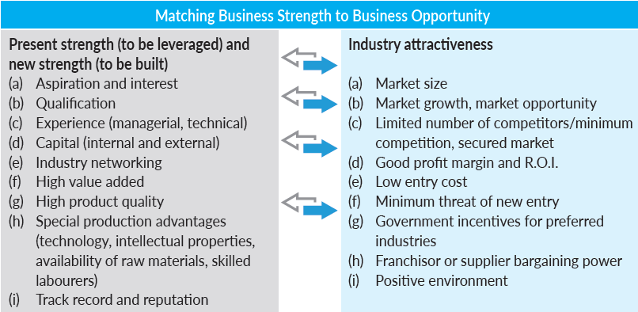
“What” of Strategy (cont.)
Matching internal strengths with external opportunities

Slide 16
Organization Objectives
The organization objectives refer to the short-term goals of the organization (for example, one to three years), which will normally include sales targets, profit targets, geographical area of operation, etc.
Ideally, objectives should have the following characteristics (SMART):
(a) Specific (b) Measurable
(c) Achievable (d) Realistic
(e) Time frame (schedule implementation)

Slide 17
Organization Structure
The organization will have to undertake certain specific tasks and these tasks can be divided into smaller tasks which can be assigned to specific personnel. This division of labour can be represented in the form of an organization structure.
Tasks on the organization chart can be divided based on functionality, such as marketing, administration, operations and finance; or geographically, such as zone A, zone B and zone C; or on products sales responsibility, such as product A, product B and product C.

Slide 18
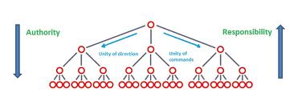
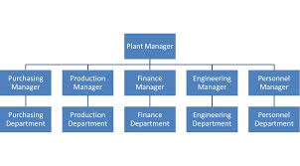
ORGANISATIONAL PRINCIPLES AND STRUCTURE
What is Organisation?
A social unit which comprises people performing different tasks in a coordinated manner to achieve organisational goals
Organisational Principles (OP)
Division of work
Authority and responsibility
Unity of Command
Span of control
Delegation of authority and responsibility.
Organisational Structure (OS)
Based on shift
Based on number of workers
Based on functions products
Based on regions
Based on shift clients

Slide 19
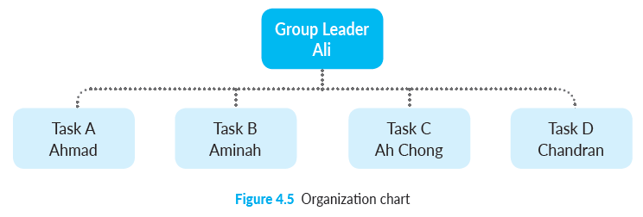
Organization Structure (cont.)
When students organize groups to undertake group entrepreneurial projects, they will have to identify key tasks that must be done and divide the tasks among group members. Figure 4.5 is an example of an organization chart.

Slide 20
Planning
An entrepreneur will have to make a long-term strategic plan, especially in choosing which business sector is suitable and offers the best opportunity for him. It is recommended for him to use the Business Model Canvas to work out his business strategies.
For a business start-up, an entrepreneur may need to do a simple project planning for main activities in the form of a Gantt chart. The Gantt chart will outline for each activity the start-up date, duration and its completion date.

Slide 21
Controlling
Controlling refers to the act of controlling and guiding the enterprise’s work, executing and monitoring work progress involving work schedules, resources, manpower, machines and space, etc. and where required activities may have to be speeded up, corrected or even stopped.
Controlling can be improved if an enterprise develops controlling documentations including outlining its mission, vision, objectives, strategies, work schedules, methodologies, manual and operating procedures, quality procedures, auditing procedures, etc.

Slide 22
Managing Entrepreneurial Growth
Entrepreneurship Technology

Slide 23
Organizational changes during growth
Entrepreneur must give up some decision making authority
Corporate culture changes from small to larger business
Such changes are often difficult for the entrepreneur and other founding members to adapt to

Slide 24
New skills for the entrepreneur
Record keeping and financial control
Inventory control
Human resources
Marketing skills
Strategic planning skills
Time management skills
Negotiation skills

Slide 25
Growth Strategies
Penetration | Product Development
Market Development | Diversification
Existing
Market
New
Existing
New
Product

Slide 26
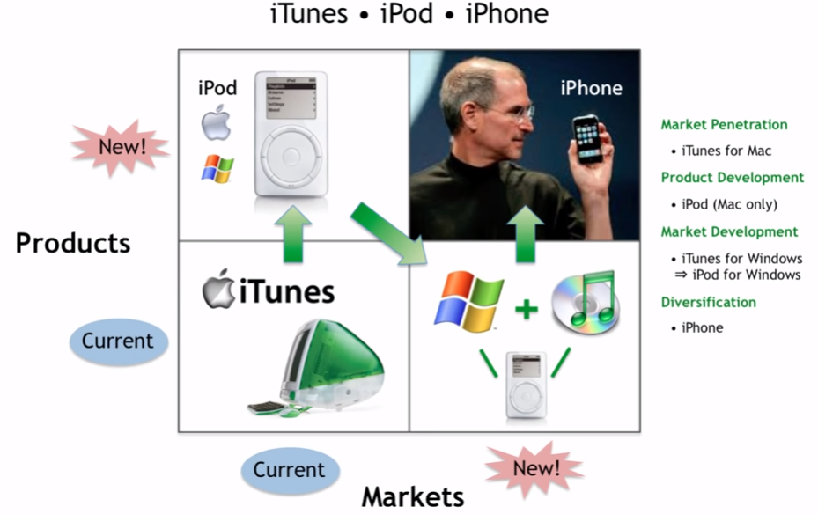
EXAMPLE

Slide 27

Strategies
Penetration- Growth By Selling More of Existing Product to Existing Customers
Market Development
New Geographic Market
New Demographic Market
New Product Use
Product Development- Sell New Products To Existing Customers
Diversification- Sell New Product To New Market

Slide 28


Pressures On Firm Growth
Existing Financial Resources
Human Resources
Management Of Employees
Entrepreneur’s Time

Slide 29


Overcoming Financial Resources Pressure
Manage Cash Flow- Budget vs. Actual
Manage Inventory
Manage Fixed Assets
Manage Costs/Profits- Compare Actual vs. Standard Percentages
Taxes
Record Keeping

Slide 30
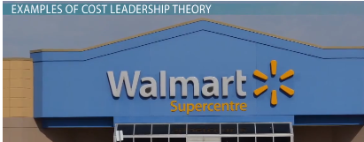
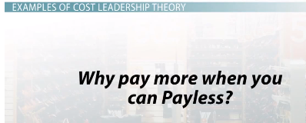
Generic Strategies
Cost Leadership
In conjunction with differentiation
Economies or diseconomies of scale
diseconomies of scale occur when the average costs of a firm increase due to increased output
Diseconomies of Scale Arises due to managerial problems
An example of a diseconomies of scale is where the firm has to hire more staff to increase sales, increase the office overheads such as communication costs in order to enhance efficient communication among the staff and hire new product managers to manage increased sales regions
Capacity utilization achieved
Linkages w/ suppliers & distributors

Slide 31
Generic Strategies
Low Cost Producer Advantage
Many price-sensitive buyers
Few ways of achieving differentiation
Buyers not sensitive to brand differences
Large no of buyers w/bargaining power

Slide 32
Generic Strategies
Differentiation
Greater product flexibility
Greater compatibility
Lower costs
Improved service
Greater convenience
More features

Slide 33
Generic Strategies
Focus
Industry segment of sufficient size
Good growth potential
Not crucial to success of major competitors

Slide 34
Three strategies for managing fast growth
Scaling
Duplication
Granulation

Slide 35
Scaling – doing more of what you are good at
Focus on concrete product, technology, or customer segment
Invest aggressively
Expand product development around core technologies, expand product lines, increase marketing using existing channels to reach new groups
Specialize and standardize
Hire the right mix
Adapt the structures
Learn from customers

Slide 36
Duplication: Repeat the business model in new regions
Balance standardization and adaptation
Hire flexible, independent managers
Duplicate key parts of the infrastructure
Duplication entrepreneurial knowledge
Be aware of the limitations

Slide 37
Granulation: Growing select business cells
Focus on specific areas of business
Balance the old and the new
Balance formal and informal
Evaluate and monitor
Learn from customers, partners, and competition

Slide 38
Understand competitors
There 3 types of competitor
Direct competitors
Compete against on a day-to day basis
Close competitors
Those that similar, but not identical products/services
Indirect competitors
More varied

Slide 39
What we can learn from competitors?
Products and services
Product line
Promotional activities
Distribution

Slide 40
Thank you
Champions believe in themselves even if no one else does. In order to succeed, we must first believe that we can. They can because they think they can.

